Slide 1
The FrienDex
Quinn Daniels, Ronan Eanes,
Kaleb McKinney, Jacob Robidas,
Dominic Erhabor

Slide 2
About the FrienDex
Description: An application to encourage social interaction by acting as a human-centered note taking app. Users can track multiple interactions with various people at different events.
Purpose: Encourage sociability by making a social media-like app for keeping records of your interactions with others.
Target User Group: Young adults, socially awkward people
Notes:
Jacob

Slide 3
Vision Statement
“to better aid human connection between people in an organized and visually memorable way”
Notes:
Jacob

Slide 4
Key Features
Fun front-end design
Multi-level organization of notes
Notes themselves have organization strategies
Notes can contain images
Notes:
Jacob

Slide 5
Architecture
Front-end Application
Local Back-end
Database hostING local vs online (TBD)
Notes:
Quinn

Slide 6
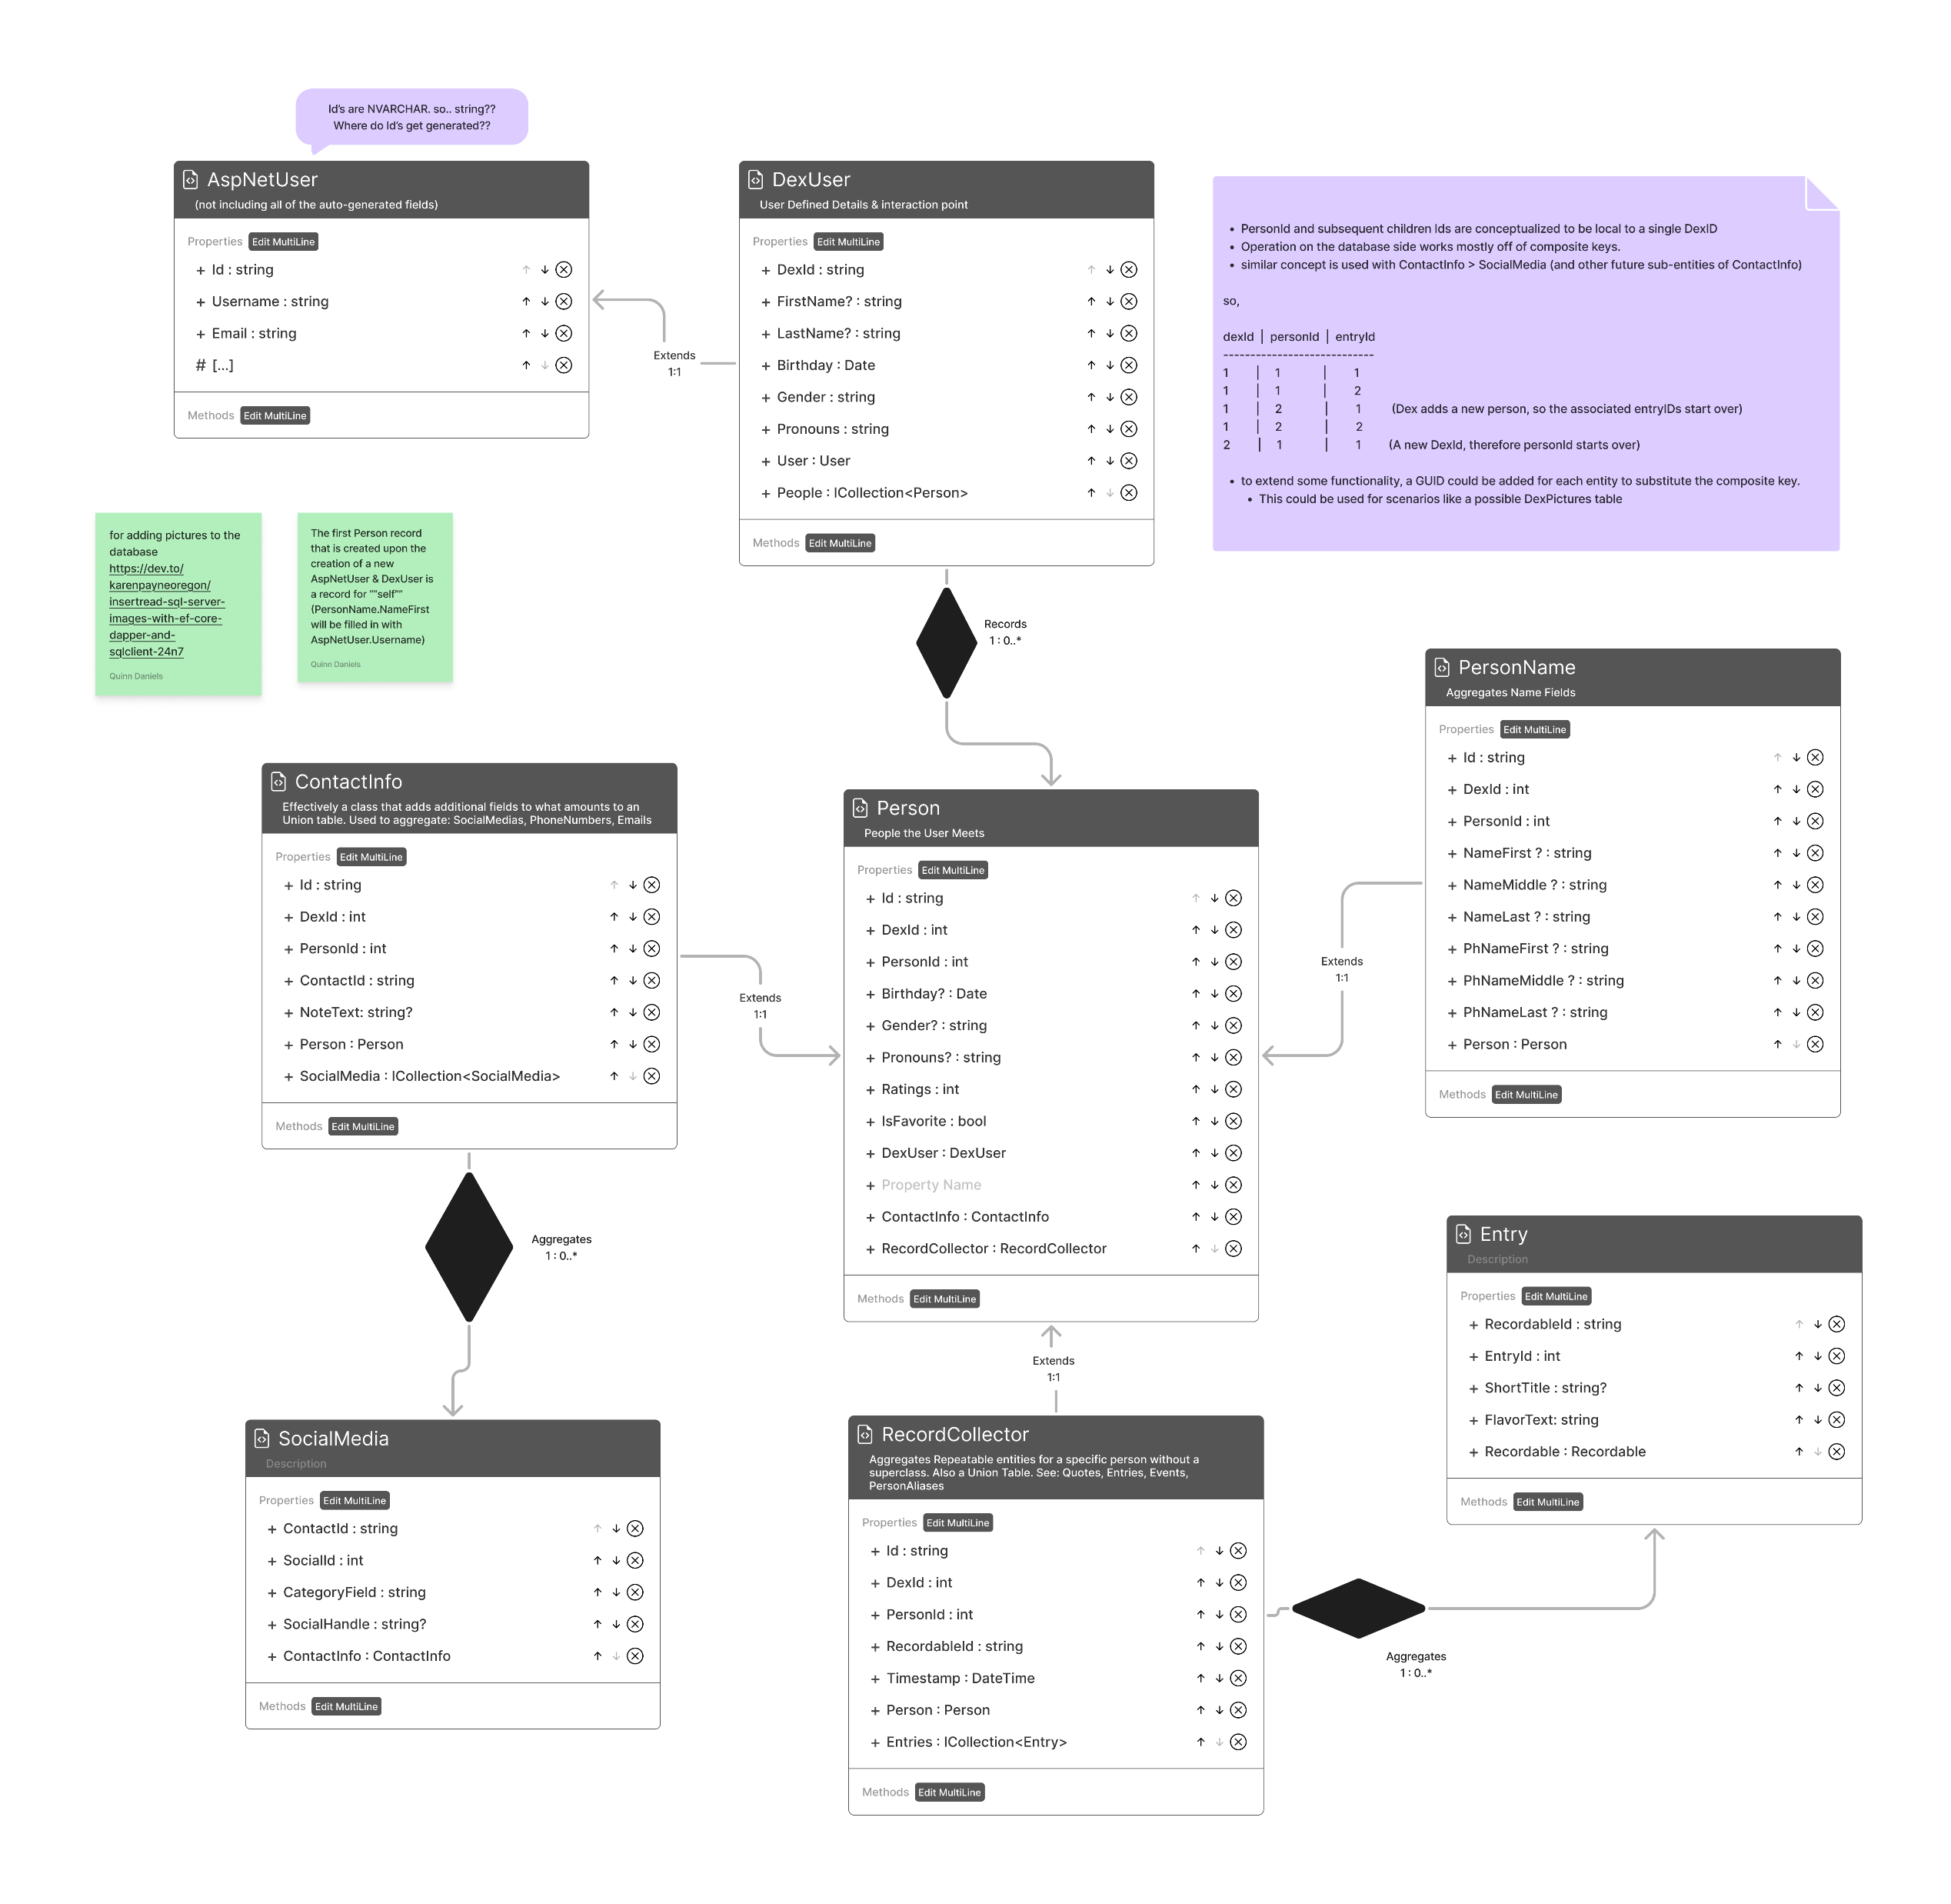


Initial Database Design Concept
PhoneNumber
Notes:
Quinn

Slide 7
System Information
Scope
Non-published Android APK
Limitations
App only runs on Android
Assumptions
User owns an Android device
Deployment Platform
Android devices
Tech Stack
local database, or online database
Notes:
Kaleb

Slide 8
Tools and External Utilities
Trello for Project Management Tracking
Github for Version Control
Neon for database storage or locally stored
Notes:
Kaleb

Slide 9
Risks:
High Database Security is required for user trust
Stakeholders could push for more addictive mechanisms
Phone APK implementation could be difficult
Mitigation Strategies:
Ensure data is appropriately encrypted
Set clear expectations early in development
Research implementation options and begin learning necessary tools early in development
Notes:
Kaleb

Slide 10
Initial Product Backlog (User Stories pt. 1)
As a student, I want to track interactions I have with people at various academic events, so that I can easily remember the people I met at particular events.
As someone who struggles to keep track of things, I want a nice way to meticulously organize my notes on the people, topics, and events that I encounter.
As someone who has moved to a new place, I want to be able to keep track of the cultural differences between my new home and what I’m used to.
Notes:
Kaleb

Slide 11
Initial Product Backlog (User Stories pt. 2)
As the mother of an introvert, I want my son to talk to his classmates more, so I want the records to be easy to create.
As a lonely young adult, I want to meet people again after the pandemic, so that I can rebuild my social group.
As someone who can be discouraged easily, I want to measure my progress, so that I can reassure myself that I am moving forward in my sociability.
Notes:
Jacob

Slide 12
Initial Product Backlog (User Stories pt. 3)
As a casual user, I want to be able to organize my friends by where I interact with them.
As a new student trying to build a network, I want to easily keep track of the career professionals I meet.
As a retro game enthusiast, I want a gamified front end that is fun to use.
Notes:
Ronan

Slide 13
Initial Product Backlog (User Stories pt. 4)
As a social butterfly, I would like to filter through the list of people that I know using tags.
As a user that has a big family, I want to be able to track the relationships (i.e., “brother of”, “coworker of”, etc) between the people in my Dex.
As a family historian, I want to quickly view a list of all of the relationships between the people in my Dex.
Notes:
Quinn

Slide 14
High Level Release Plan
Setup and connect GitHub, Database, Trello, Research Front-end App
Database CRRUD functionalities, User folders, and other gamified features
Add all front-end access points and features
Test Feature Implementation and Bug Fix
Visuals
Test Full Implementation and Bug Fix
Sprint 1 Sprint 2-5 Sprint 6 Sprint 7 Sprint 8-9 Sprint 10
Notes:
Ronan

Slide 15
Focus Plan for Sprint 1
Setup GitHub repo for the project
Create backlog and Sprint 1 items in Trello
Research mobile application creation
Finalize decision on which dev tools and software to create application with/in
Notes:
Ronan

Slide 16

Thanks

